Slide 1
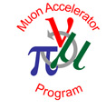

Hybrid Methods for Simulation of Muon Ionization Cooling Channels
Josiah D. Kunz
Thesis Defense
Monday, August 22nd, 2016

Slide 2
Outline

Slide 3
Outline
Motivation
Fundamental particle physics
The Higgs Boson
Neutrinos
Muon facilities

Slide 4
Outline
Motivation
Fundamental particle physics
The Higgs Boson
Neutrinos
Muon facilities
Introduction to COSY Infinity
Transfer map methods
Transfer map example

Slide 5
Outline
Motivation
Fundamental particle physics
The Higgs Boson
Neutrinos
Muon facilities
Introduction to COSY Infinity
Transfer map methods
Transfer map example
Stochastic Processes
Ionization cooling
Why not use transfer maps?
Energy straggling
Multiple scattering

Slide 6
Outline
Motivation
Fundamental particle physics
The Higgs Boson
Neutrinos
Muon facilities
Introduction to COSY Infinity
Transfer map methods
Transfer map example
Stochastic Processes
Ionization cooling
Why not use transfer maps?
Energy straggling
Multiple scattering
Results
Validation
Benchmarking
MICE

Slide 7
Outline
Motivation
Fundamental particle physics
The Higgs Boson
Neutrinos
Muon facilities
Introduction to COSY Infinity
Transfer map methods
Transfer map example
Stochastic Processes
Ionization cooling
Why not use transfer maps?
Energy straggling
Multiple scattering
Results
Validation
Benchmarking
MICE
Summary

Slide 8
Outline
Motivation
Fundamental particle physics
The Higgs Boson
Neutrinos
Muon facilities
Introduction to COSY Infinity
Transfer map methods
Transfer map example
Stochastic Processes
Ionization cooling
Why not use transfer maps?
Energy straggling
Multiple scattering
Results
Validation
Benchmarking
MICE
Summary

Slide 9
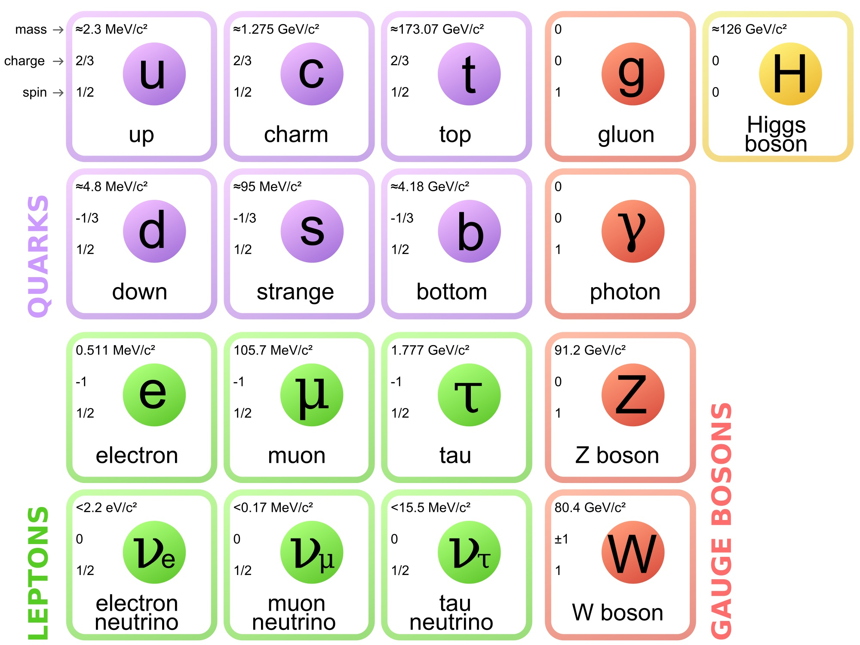
Motivation: Fundamental Particle Physics
Protons, neutrons
Interesting fundamental particles!

Slide 10
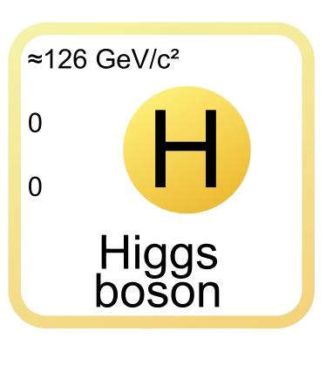
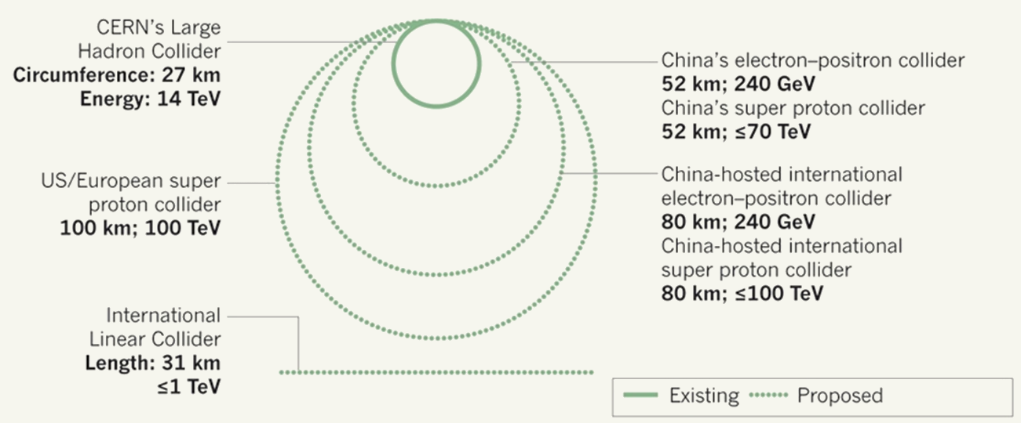
Motivation: Higgs Challenges
Want to study the Higgs boson
Discovered via protons
Requires large facility
Large Hadron Collider (LHC) is 8.4 km in diameter
Proposed accelerators only get bigger

Slide 11
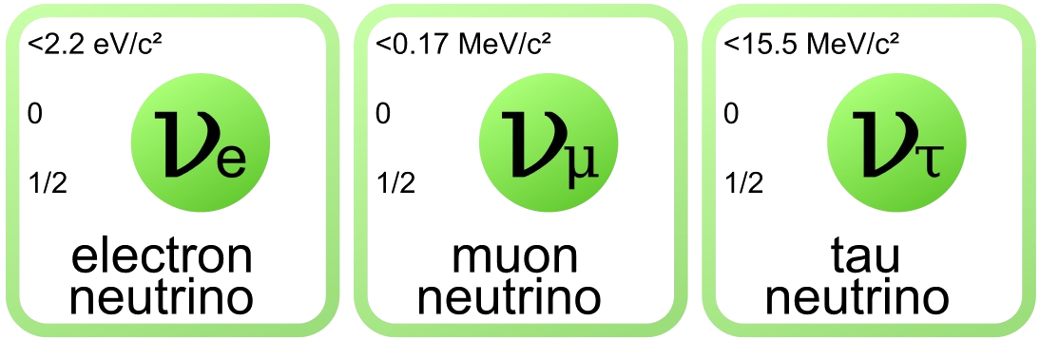
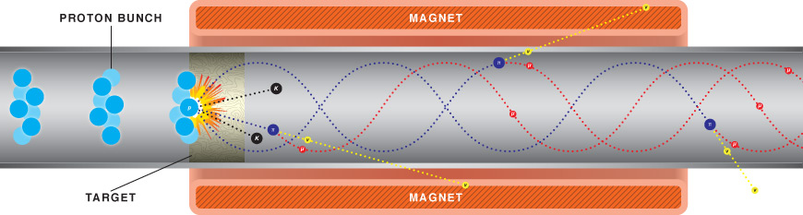
Motivation: Neutrino Challenges
Neutrinos can mix flavors
Need long experiment to allow flavor mixing
Neutrinos are neutral
Cannot focus
Neutrinos produced via decay

Slide 12
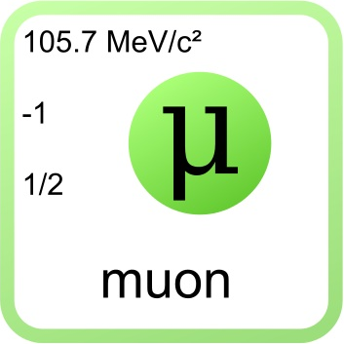
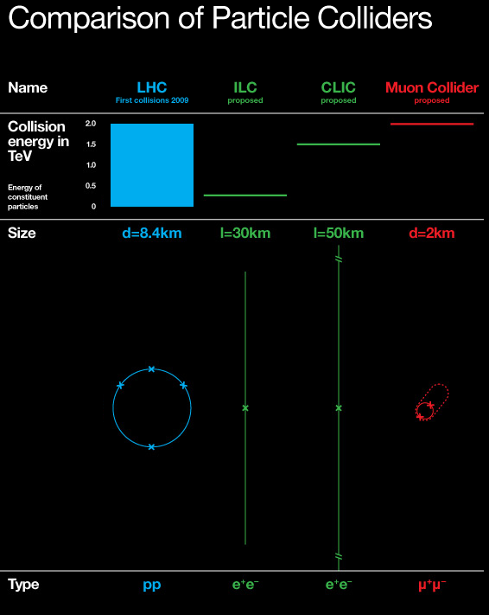
Motivation: Muon Facilities
Recap:
Higgs facilities are too large and costly
Neutrino facilities have potential for improvement
Muon facilities solve both problems
Muons are fundamental (unlike protons), so small facility is possible
Muons decay to produce neutrinos, but can be focused first

Slide 13
Outline
Motivation
Fundamental particle physics
The Higgs Boson
Neutrinos
Muon facilities
Introduction to COSY Infinity
Transfer map methods
Transfer map example
Stochastic Processes
Ionization cooling
Why not use transfer maps?
Energy straggling
Multiple scattering
Results
Validation
Benchmarking
MICE
Summary

Slide 14
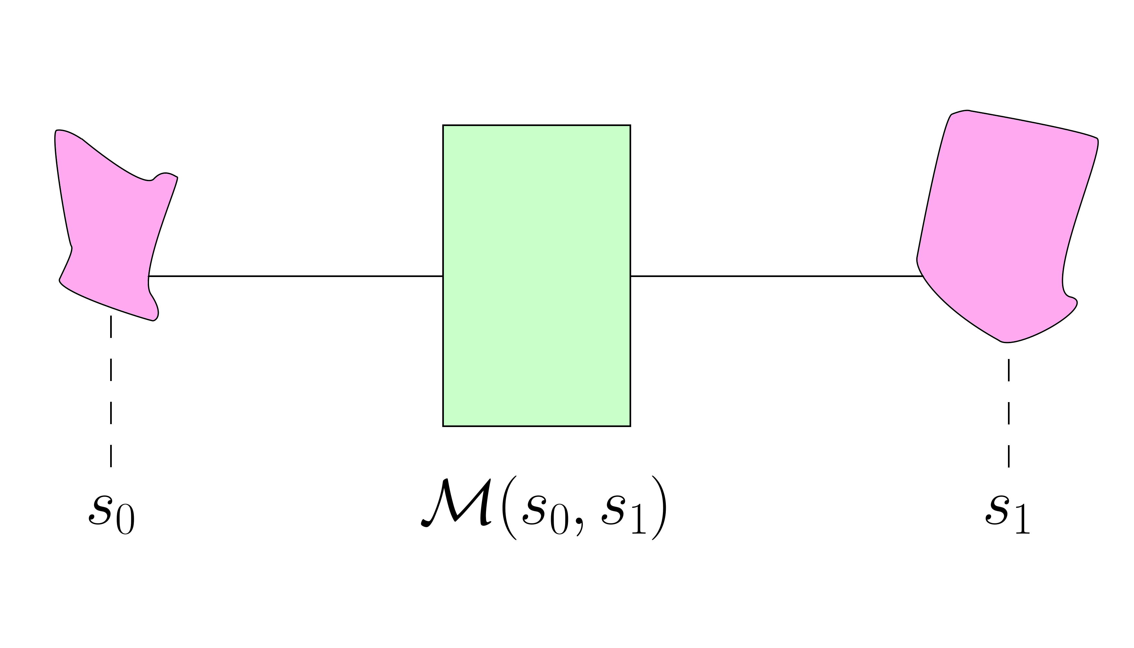
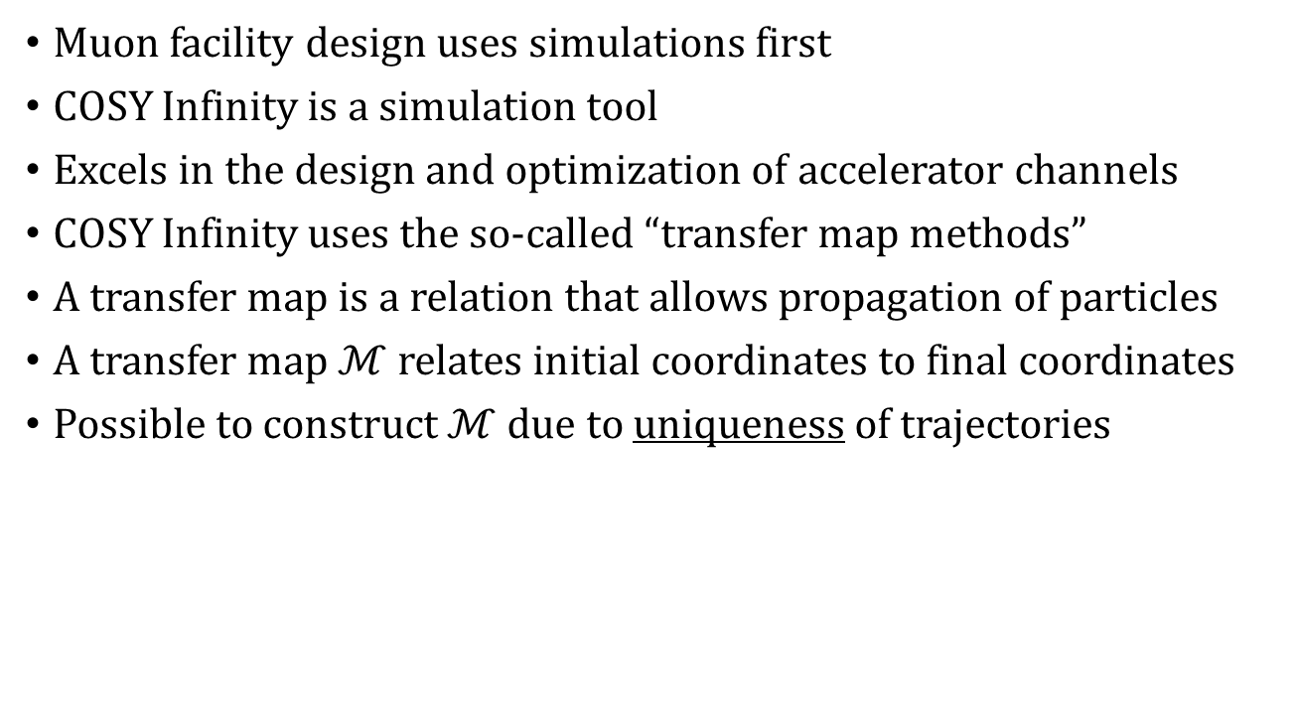
Introduction: Transfer Map Methods
Muon facility design uses simulations first
COSY Infinity is a simulation tool
Excels in the design and optimization of accelerator channels
COSY Infinity uses the so-called “transfer map methods”
A transfer map is a relation that allows propagation of particles
A transfer map $ℳ$ relates initial coordinates to final coordinates
Possible to construct $ℳ$ due to uniqueness of trajectories

Slide 15
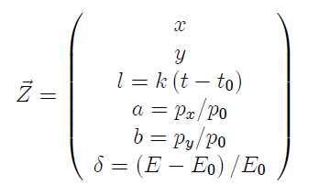
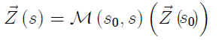
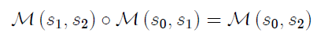
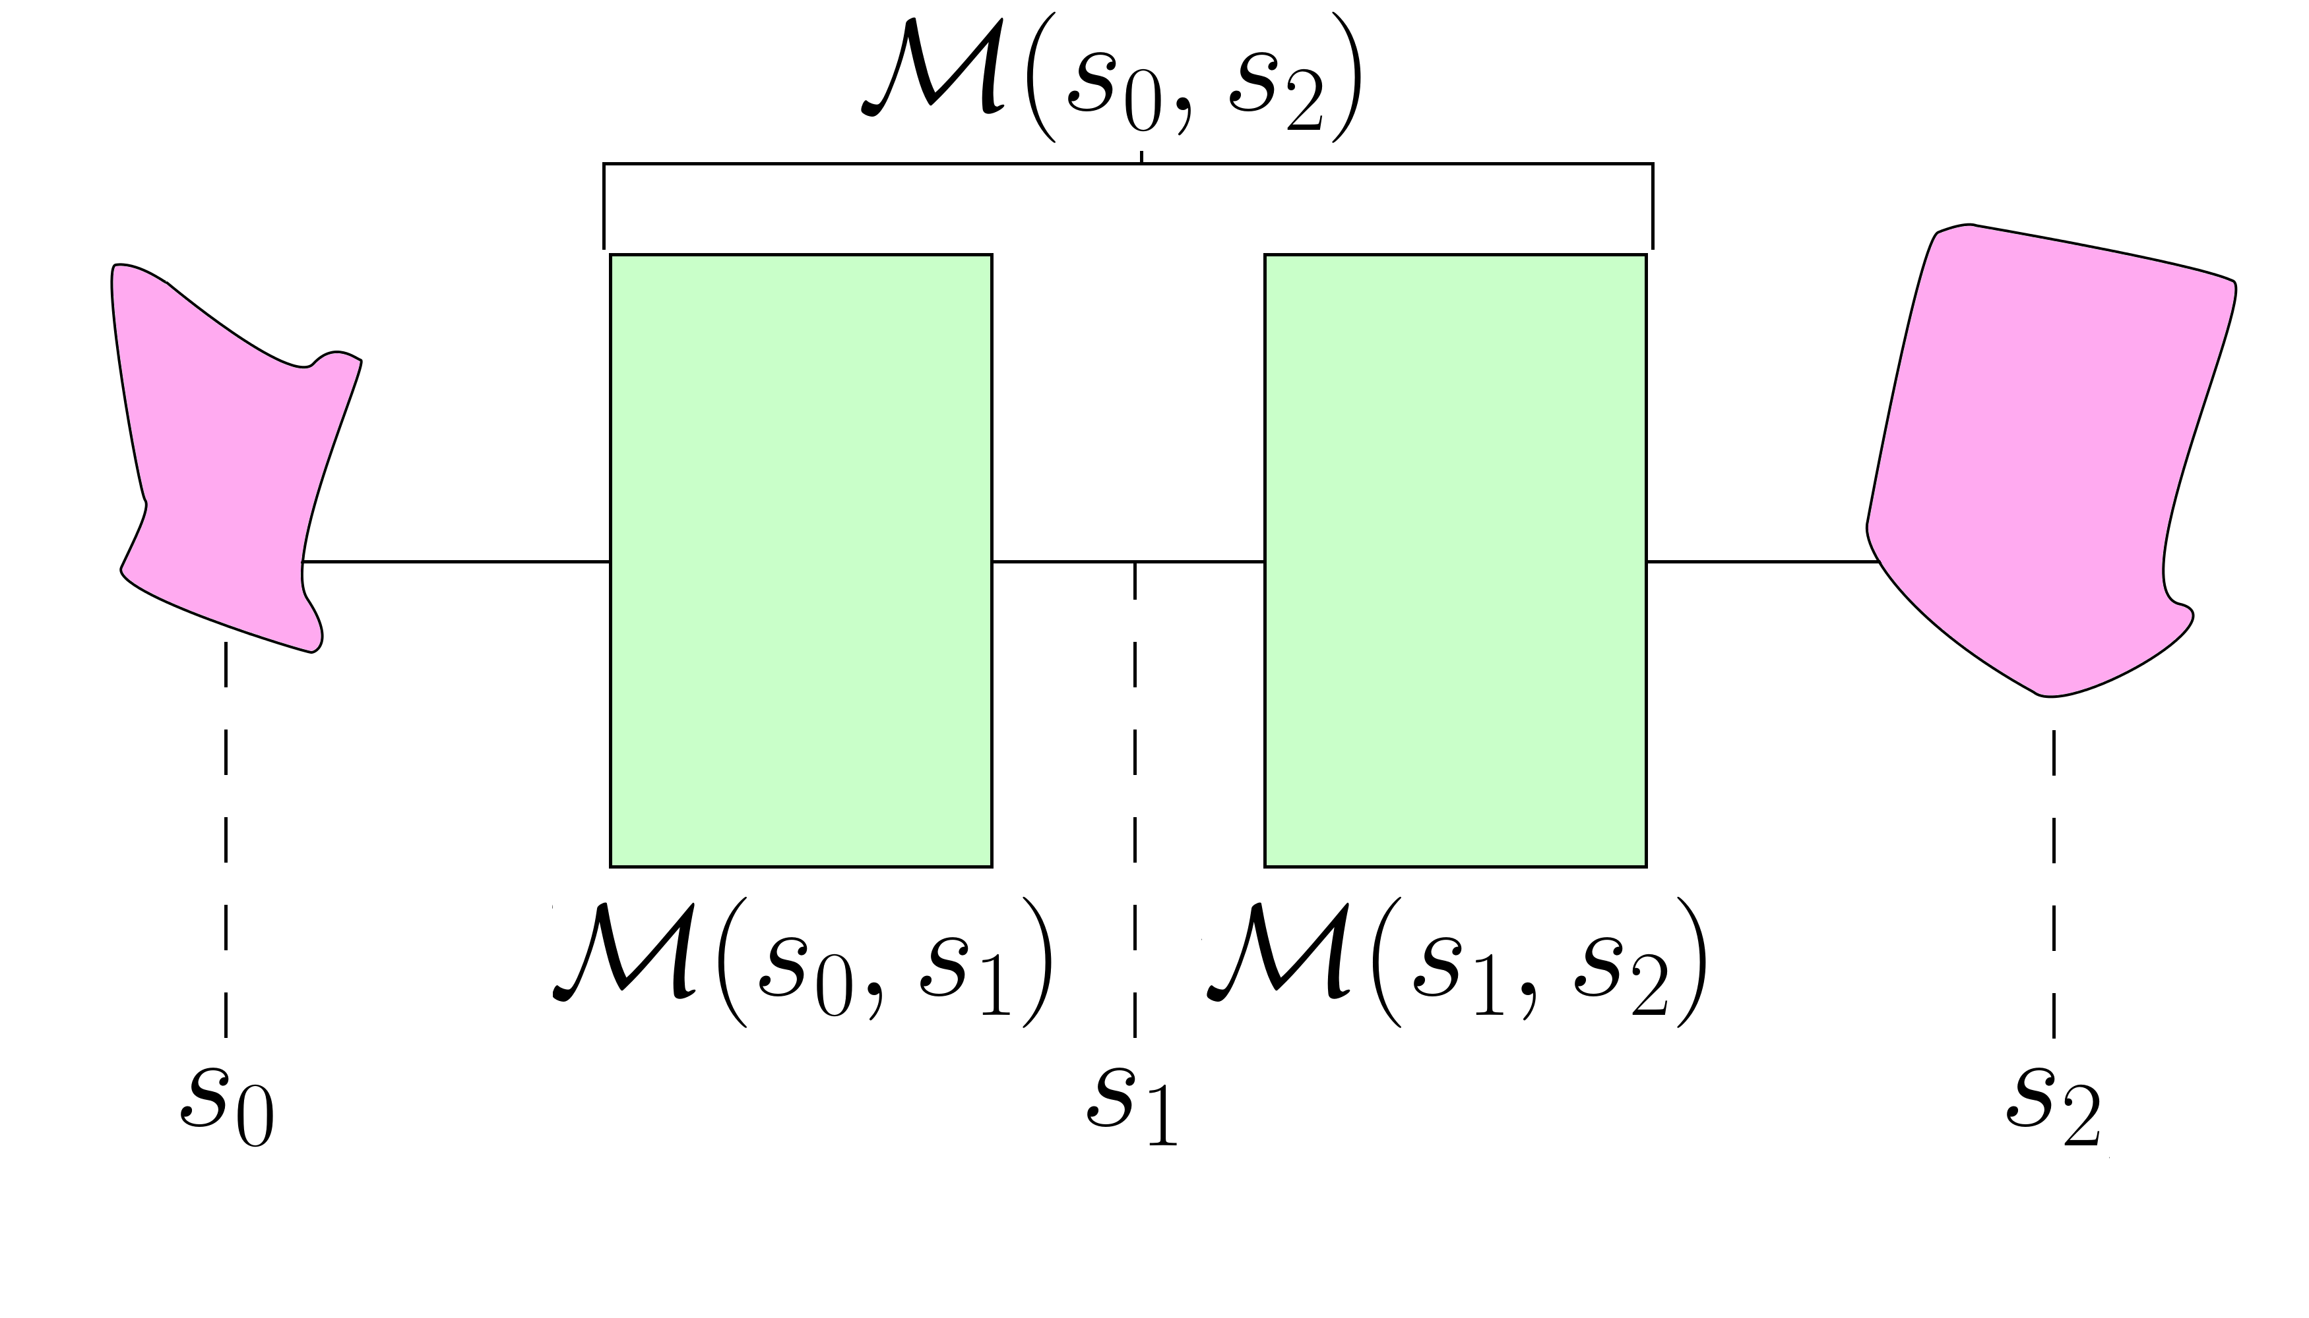
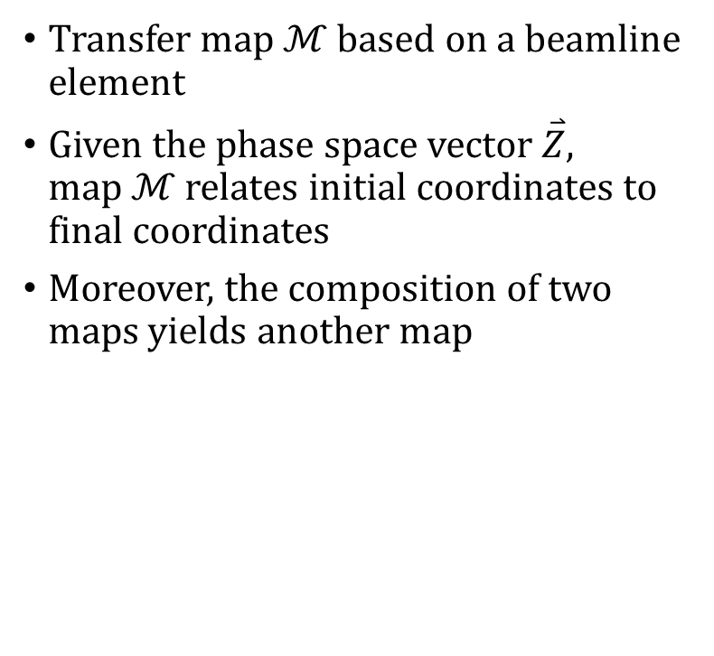
Introduction: Transfer Map Methods
Transfer map $ℳ$ based on a beamline element
Given the phase space vector $\overset{⃑}{Z}$, map $ℳ$ relates initial coordinates to final coordinates
Moreover, the composition of two maps yields another map

Slide 16
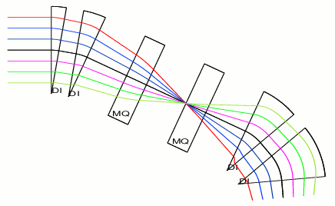
Introduction: Transfer Map Example

Slide 17
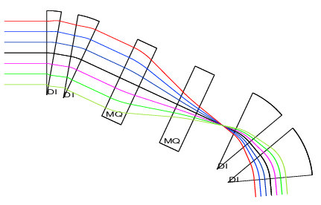
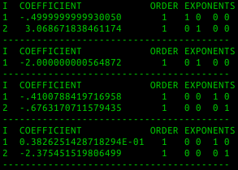
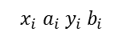
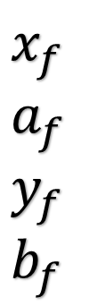
Introduction: Transfer Map Example
$$x_{i} a_{i} y_{i} b_{i}$$
$$x_{f} \\ a_{f} \\ y_{f} \\ b_{f}$$

Slide 18
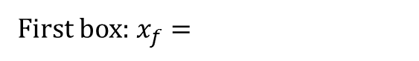
Introduction: Transfer Map Example
$$x_{i} a_{i} y_{i} b_{i}$$
$$x_{f} \\ a_{f} \\ y_{f} \\ b_{f}$$
First box: $x_{f}=$

Slide 19
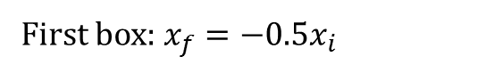
Introduction: Transfer Map Example
$$x_{i} a_{i} y_{i} b_{i}$$
$$x_{f} \\ a_{f} \\ y_{f} \\ b_{f}$$
First box: $x_{f}=−0.5x_{i}$

Slide 20
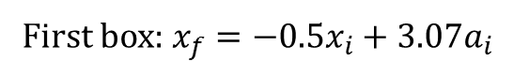
Introduction: Transfer Map Example
$$x_{i} a_{i} y_{i} b_{i}$$
$$x_{f} \\ a_{f} \\ y_{f} \\ b_{f}$$
First box: $x_{f}=−0.5x_{i}+3.07a_{i}$

Slide 21
Introduction: Transfer Map Example
$$x_{i} a_{i} y_{i} b_{i}$$
$$x_{f} \\ a_{f} \\ y_{f} \\ b_{f}$$
0
First box: $x_{f}=−0.5x_{i}+3.07a_{i}$

Slide 22
Introduction
Want to use COSY transfer map approach to study muon facilities
Fast!
Particles can be simulated through many meters via single map
Matrix multiplication instead of particle-by-particle propagation

Slide 23
Outline
Motivation
Fundamental particle physics
The Higgs Boson
Neutrinos
Muon facilities
Introduction to COSY Infinity
Transfer map methods
Transfer map example
Stochastic Processes
Ionization cooling
Why not use transfer maps?
Energy straggling
Multiple scattering
Results
Validation
Benchmarking
MICE
Summary

Slide 24
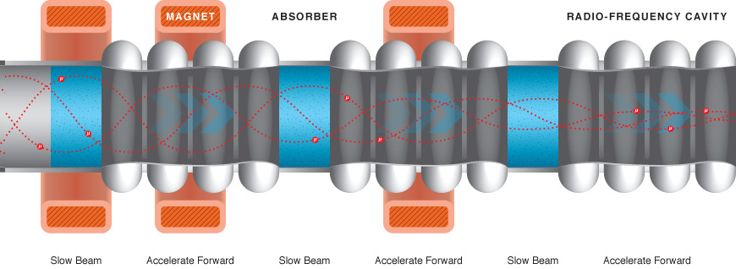
Stochastic Processes: Ionization Cooling
Recall: muons decay
Best method of collecting, focusing, and accelerating muons is “ionization cooling”
“Absorber” – low-Z material (e.g. liquid hydrogen)
Beam ionizes the material; beam loses momentum
Radio frequency cavity restores longitudinal momentum
Result: reduced transverse momentum

Slide 25
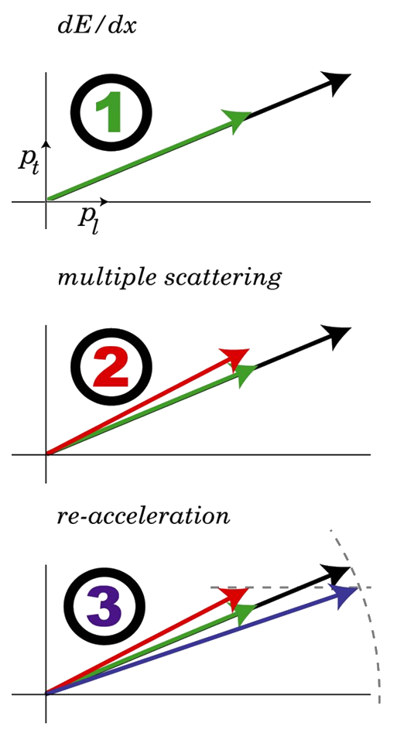
Stochastic Processes: Ionization Cooling
dE/dx Beam loses momentum, both transverse and longitudinal.
Multiple scattering Transverse momentum grows due to scattering effects.
Re-acceleration Longitudinal momentum increased via RF cavity. Total momentum remains the same. Transverse momentum reduced.

Slide 26
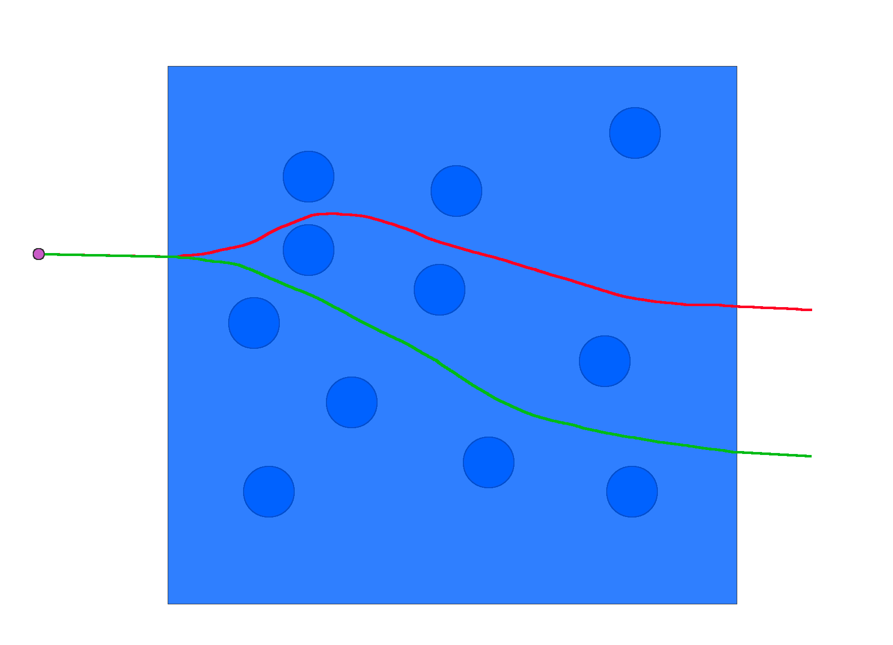
Stochastic Processes: Why not use maps?
It is only possible to construct a transfer map if the particle has a unique evolution
This is not true due to energy straggling, multiple scattering
Quantum effects → intrinsically random
Stochastic processes do not fit into the transfer map paradigm

Slide 27
Goal
Outfit COSY Infinity with tools to handle stochastic processes
Energy straggling
Multiple scattering
Should be particle-by-particle propagation, not transfer maps
Still use transfer maps where possible
Validate against experimental data
Benchmark against other codes
Apply to simulations of cooling channels

Slide 28
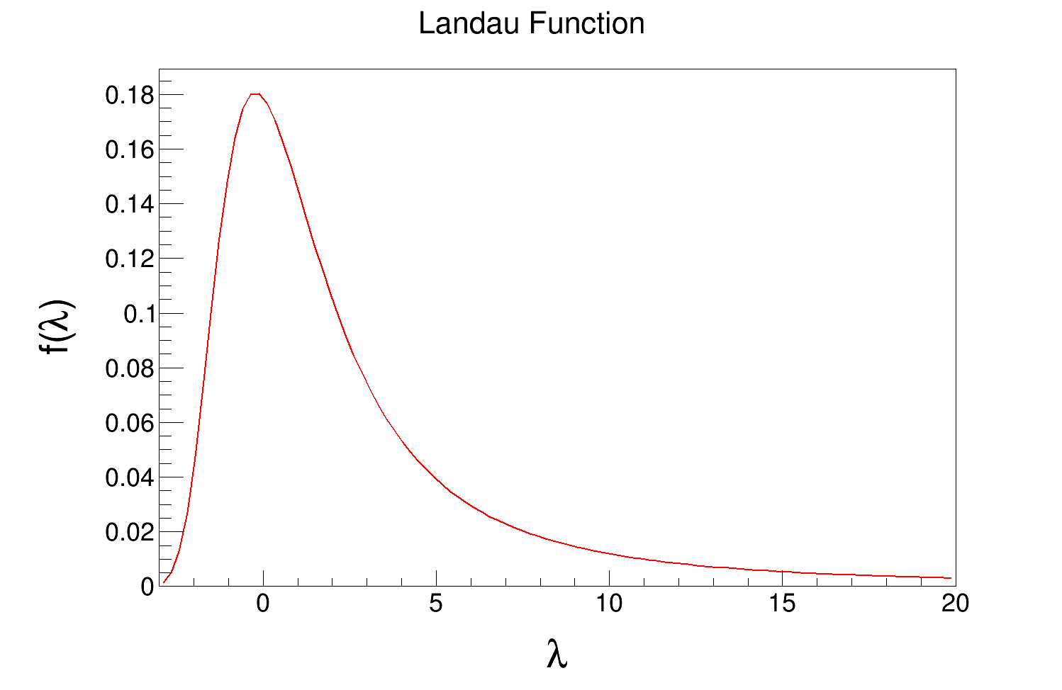
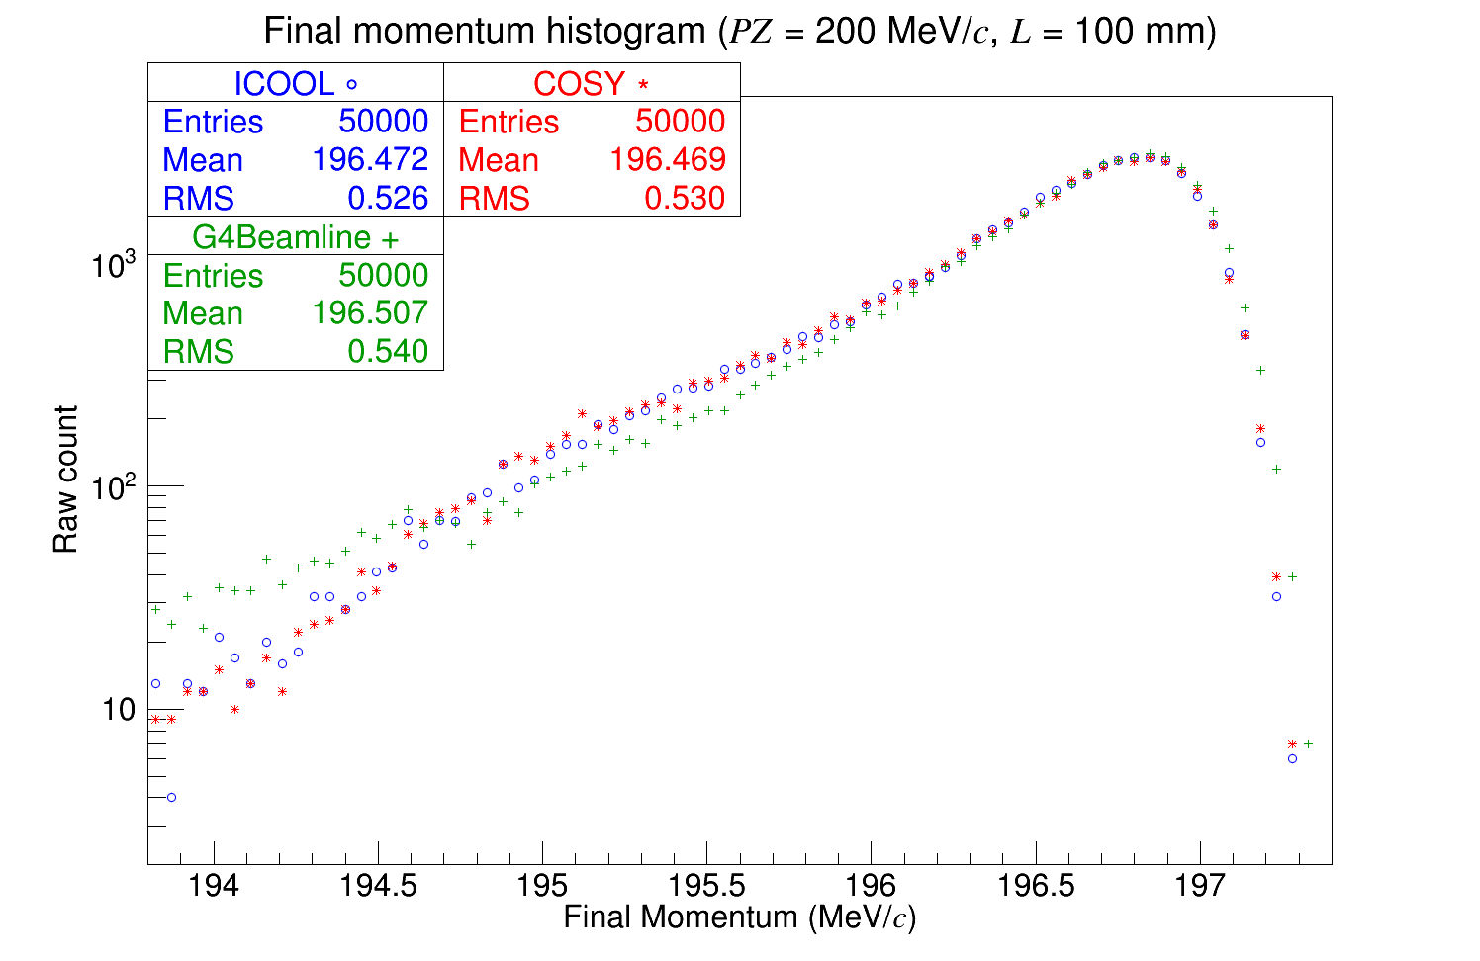
Stochastic Processes: Energy Straggling
Energy straggling: random fluctuations about a mean energy loss
Landau theory describes this well

Slide 29
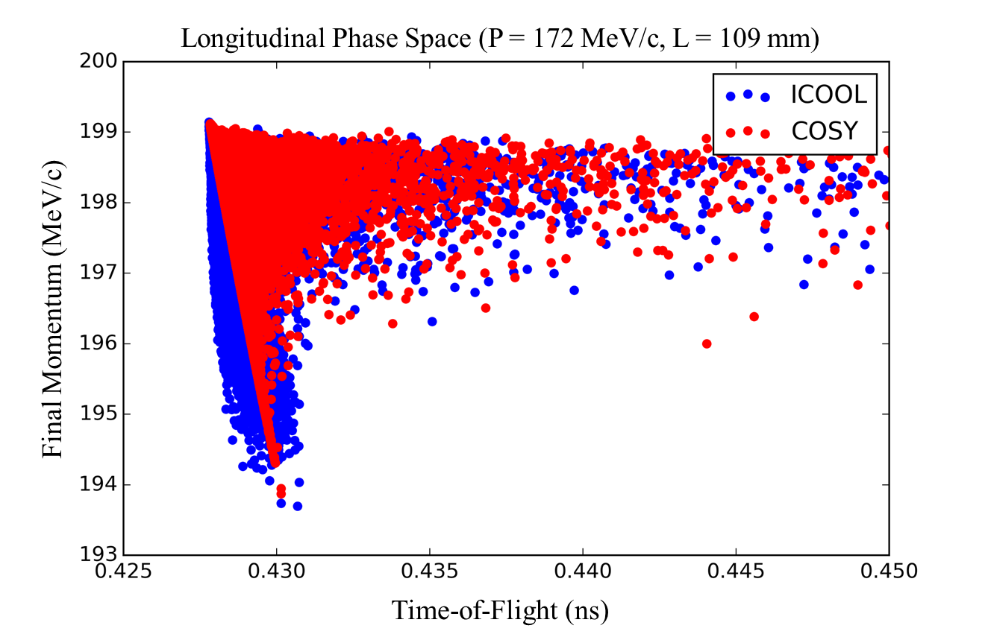
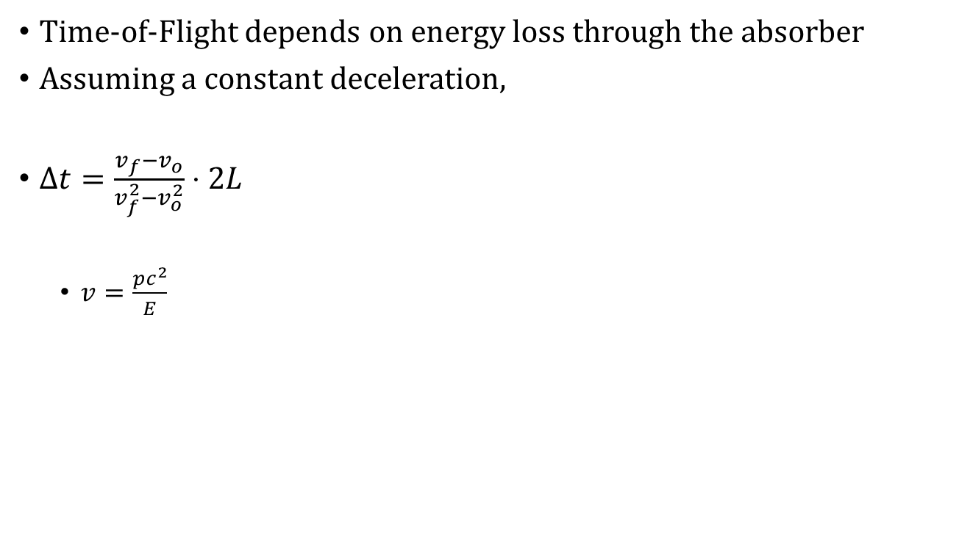
Stochastic Processes: Energy Straggling
Time-of-Flight depends on energy loss through the absorber
Assuming a constant deceleration,
$Δt=\frac{v_{f}−v_{o}}{v_{f}^{2}−v_{o}^{2}}⋅2L$
$v=\frac{pc^{2}}{E}$

Slide 30
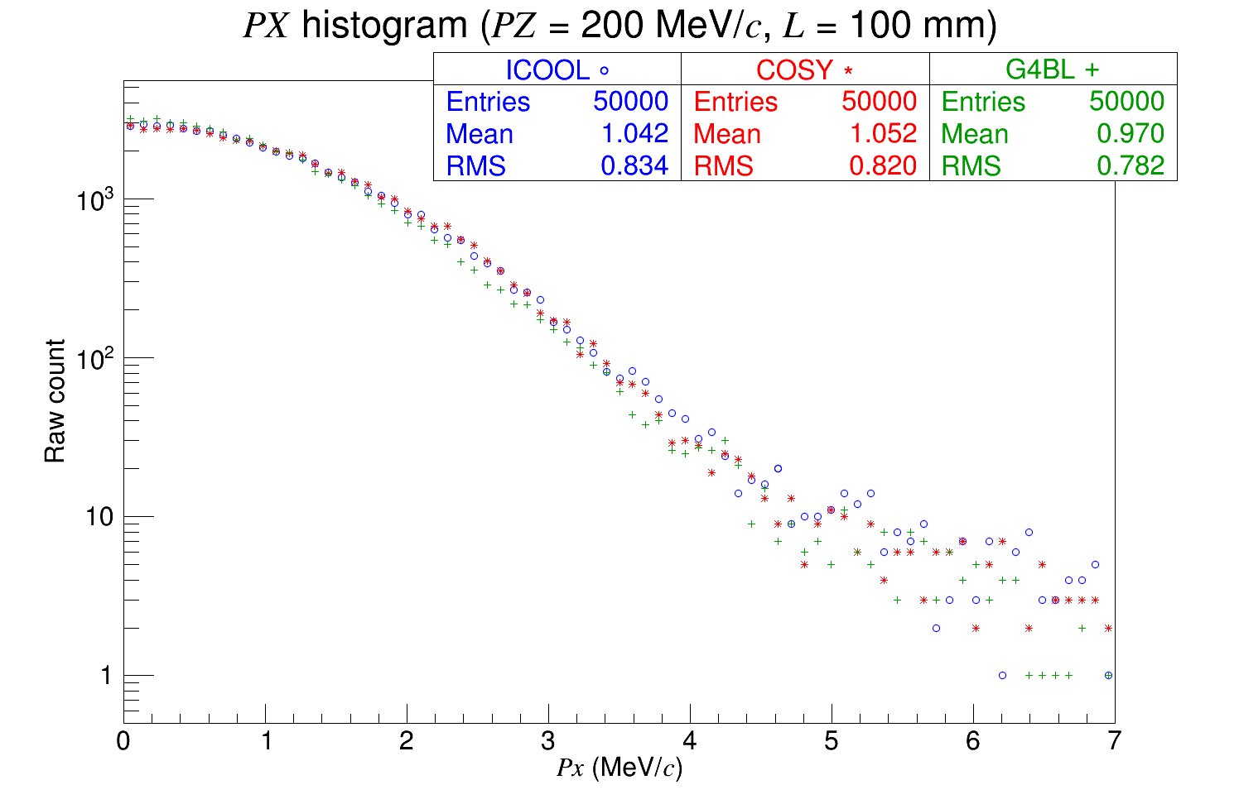
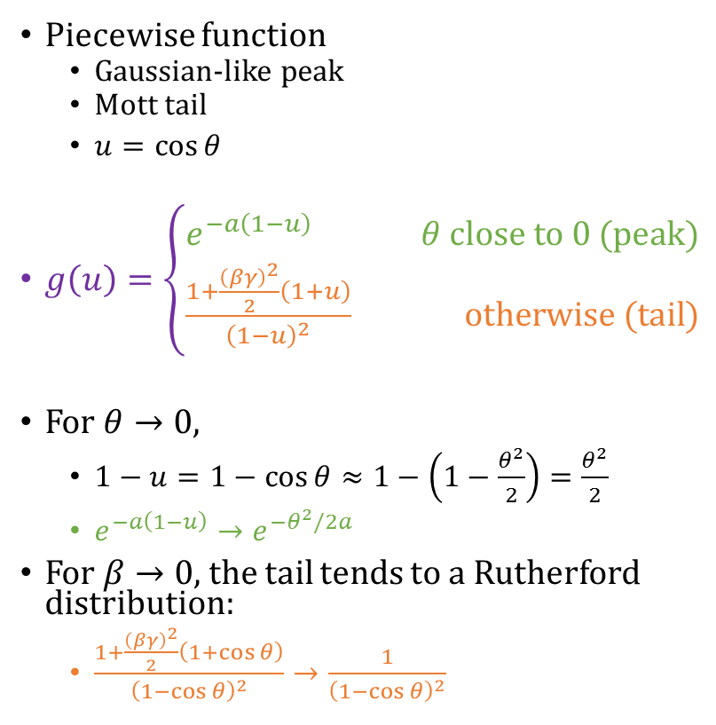
Stochastic Processes: Multiple Scattering
Piecewise function
Gaussian-like peak
Mott tail
$u=\cos{θ}$
$g\left(u\right)=\left\{\begin{aligned}e^{−a\left(1−u\right)} θ close to 0 (peak) \\ \frac{1+\frac{{\left(βγ\right)}^{2}}{2}\left(1+u\right)}{{\left(1−u\right)}^{2}} otherwise (tail)\end{aligned}\right.$
For $θ→0$,
$1−u=1−\cos{θ}≈1−\left(1−\frac{θ^{2}}{2}\right)=\frac{θ^{2}}{2}$
$e^{−a\left(1−u\right)}→e^{−θ^{2}/2a}$
For $β→0$, the tail tends to a Rutherford distribution:
$\frac{1+\frac{{\left(βγ\right)}^{2}}{2}\left(1+\cos{θ}\right)}{{\left(1−\cos{θ}\right)}^{2}}→\frac{1}{{\left(1−\cos{θ}\right)}^{2}}$

Slide 31
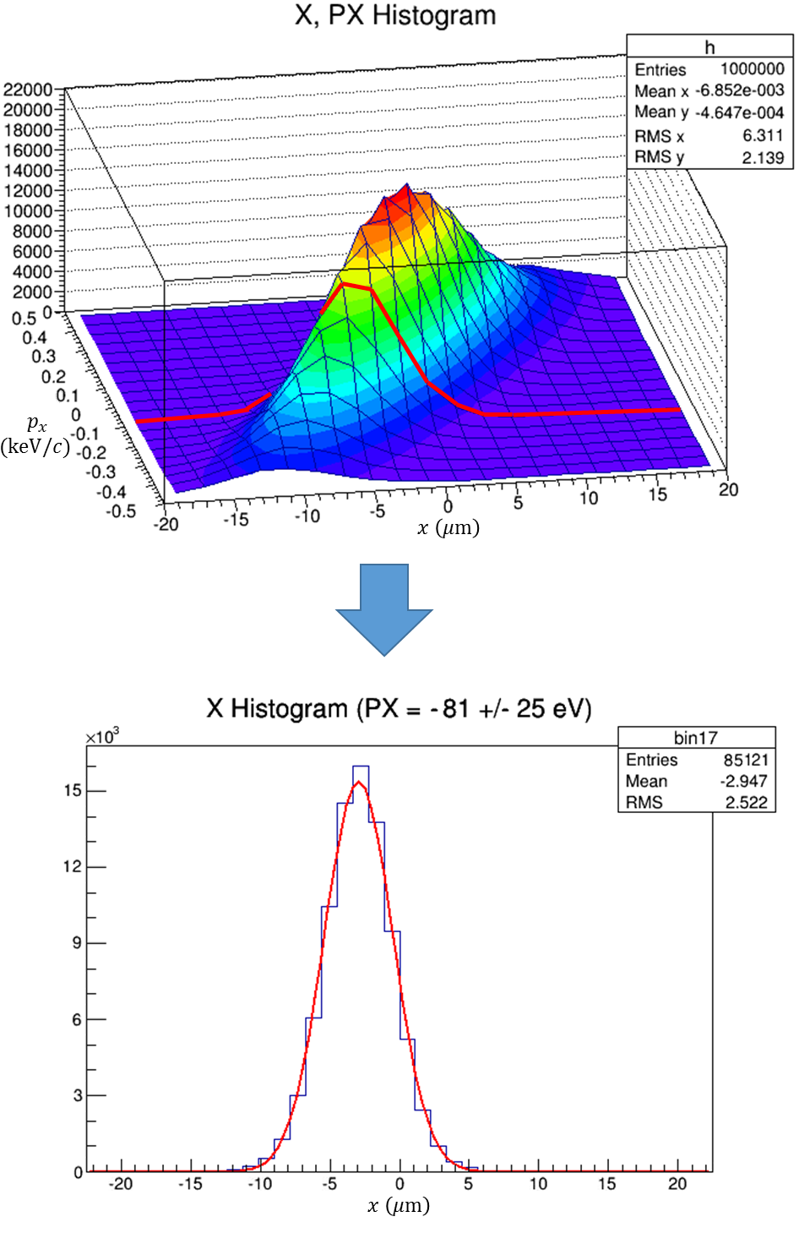
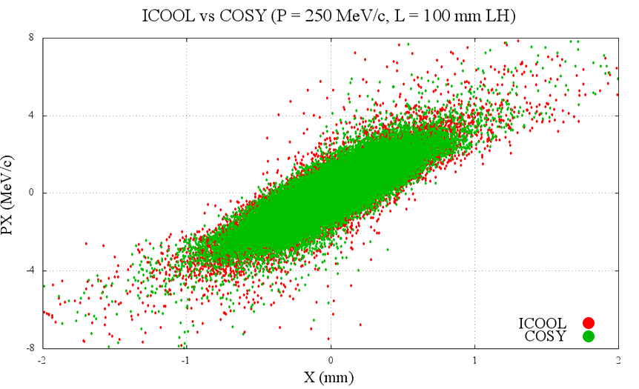
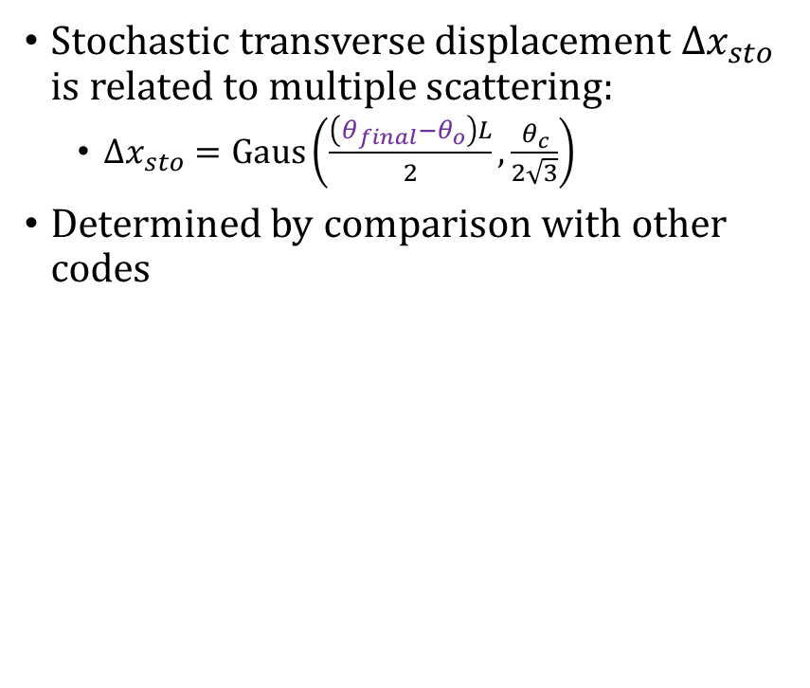
Stochastic Processes: Multiple Scattering
Stochastic transverse displacement $Δx_{sto}$ is related to multiple scattering:
$Δx_{sto}=Gaus\left(\frac{\left(θ_{final}−θ_{o}\right)L}{2},\frac{θ_{c}}{2\sqrt{3}}\right)$
Determined by comparison with other codes

Slide 32
Outline
Motivation
Fundamental particle physics
The Higgs Boson
Neutrinos
Muon facilities
Introduction to COSY Infinity
Transfer map methods
Transfer map example
Stochastic Processes
Ionization cooling
Why not use transfer maps?
Energy straggling
Multiple scattering
Results
Validation
Benchmarking
MICE
Summary

Slide 33
Results: Validation
Validation: testing new software against experimental results
Stochastic processes were further altered to give agreement with experimental results from MuScat

Slide 34
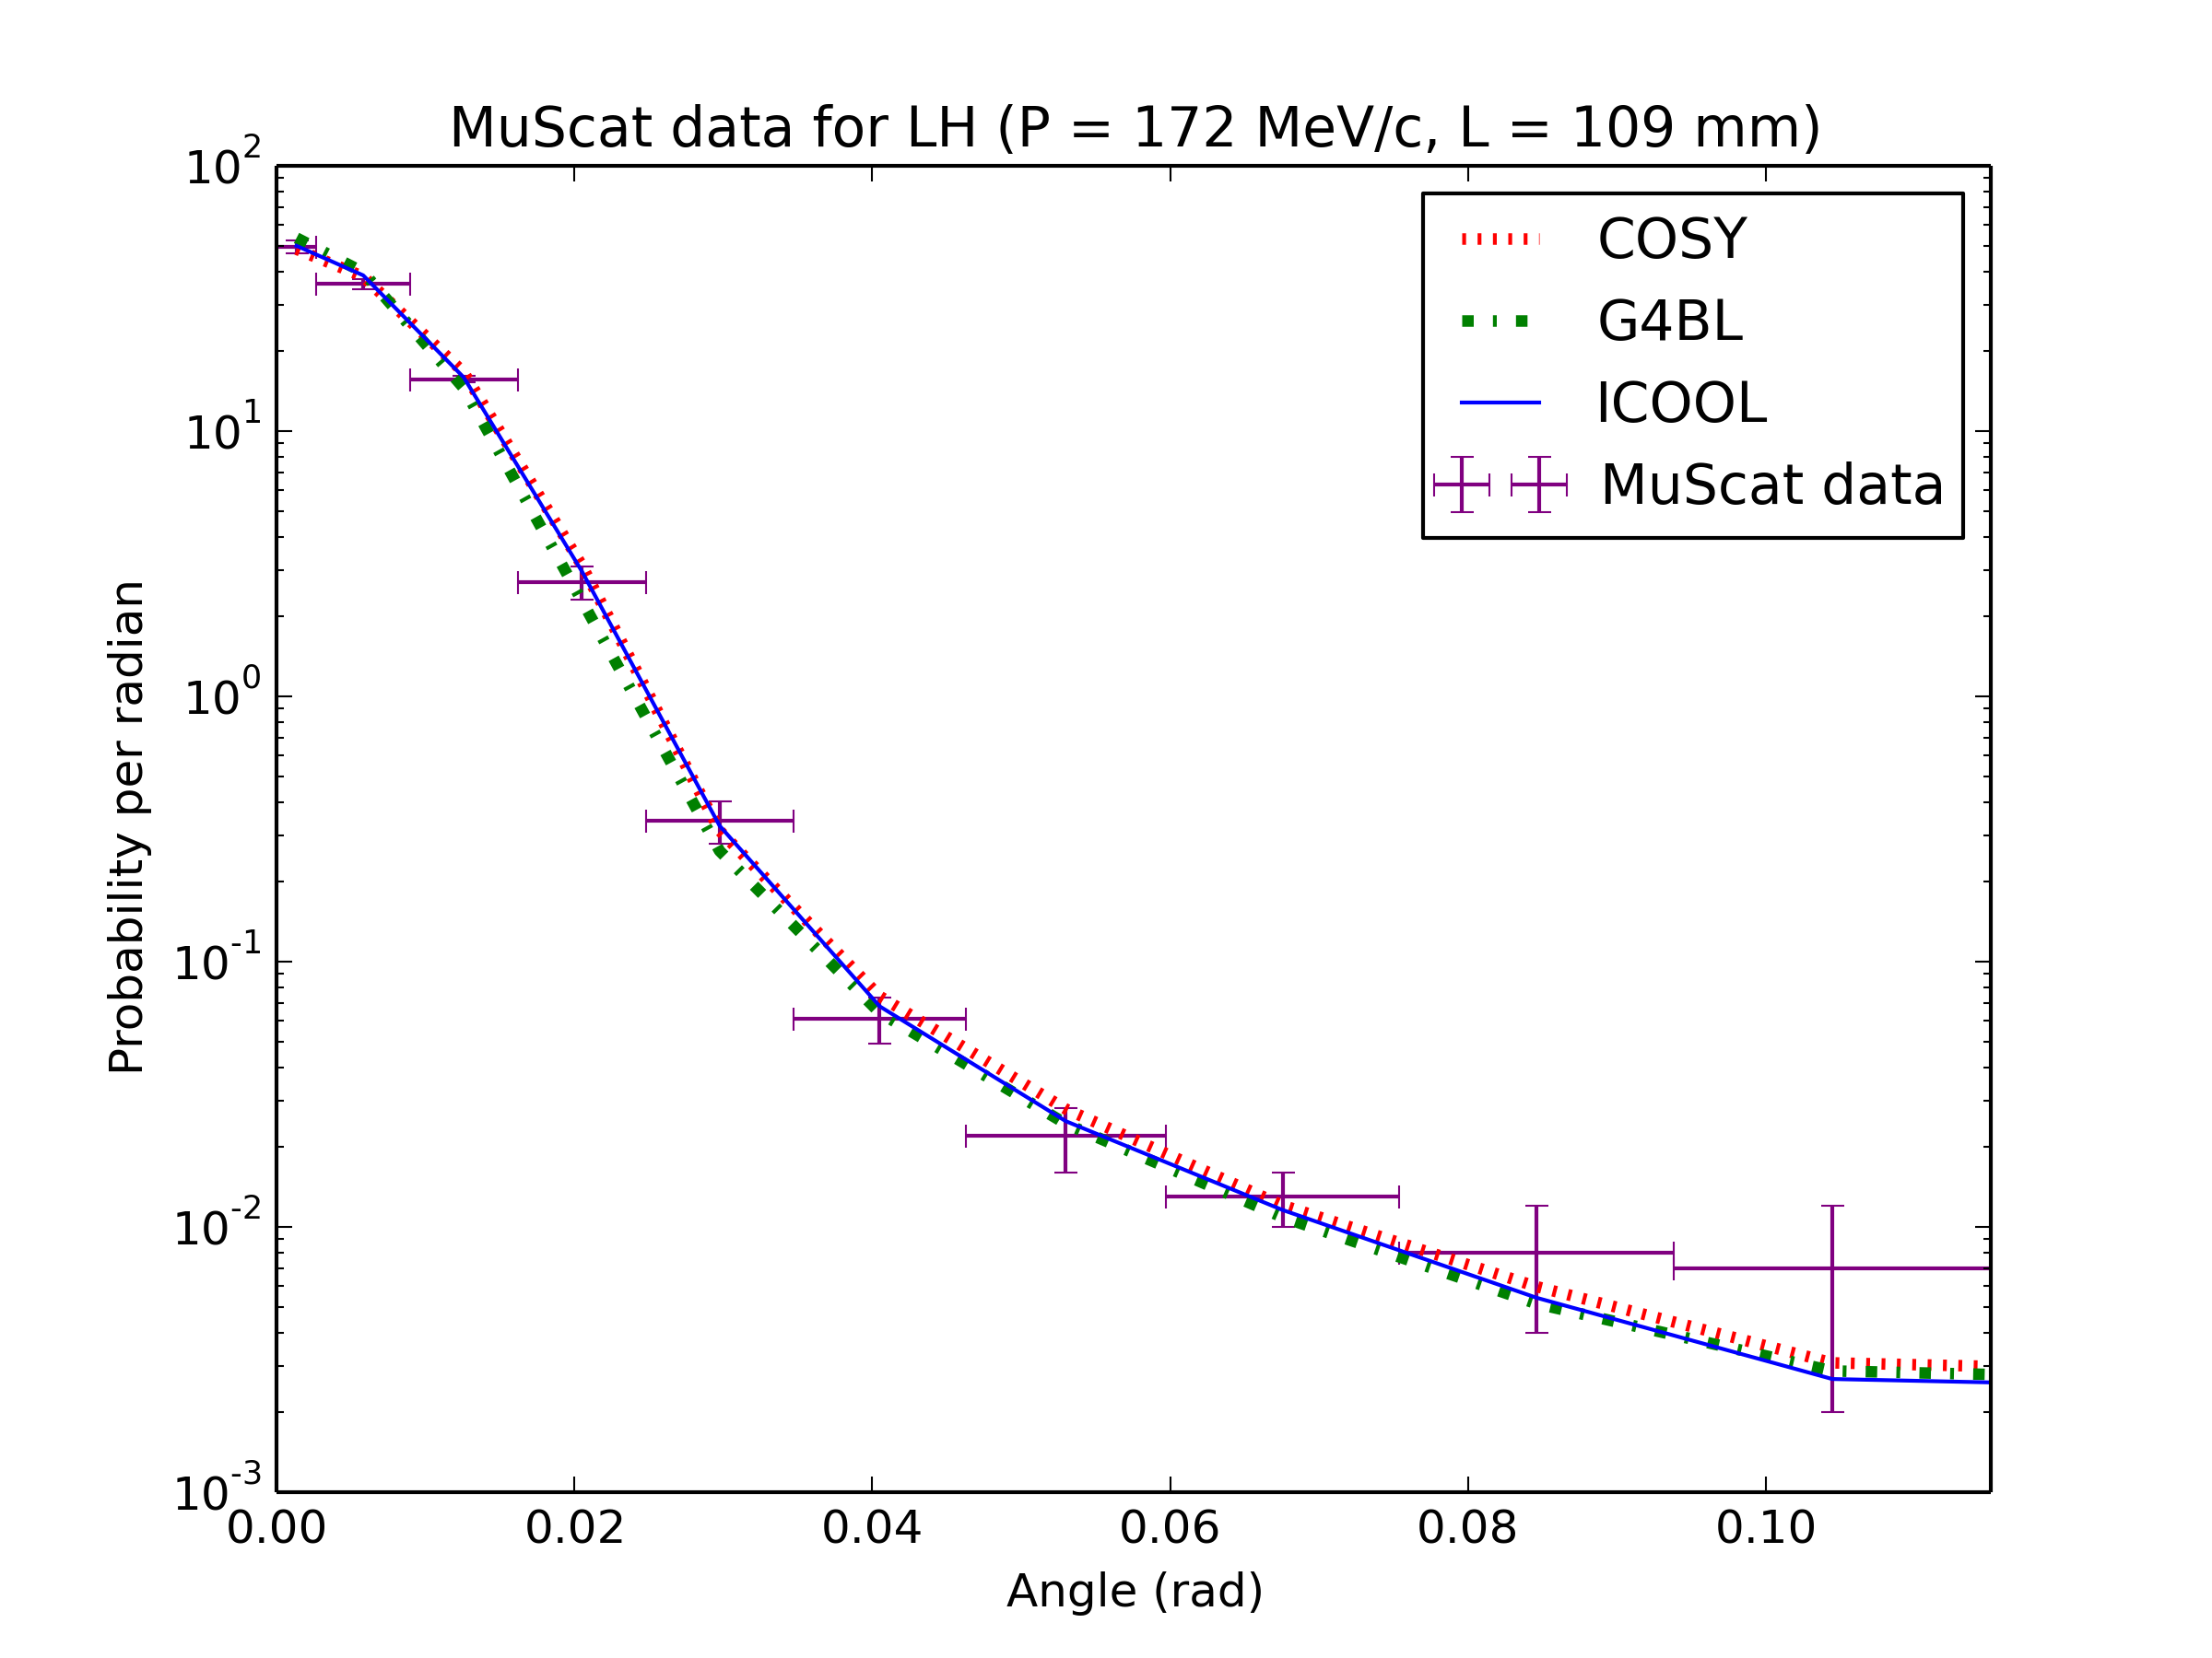
Results: Validation

Slide 35
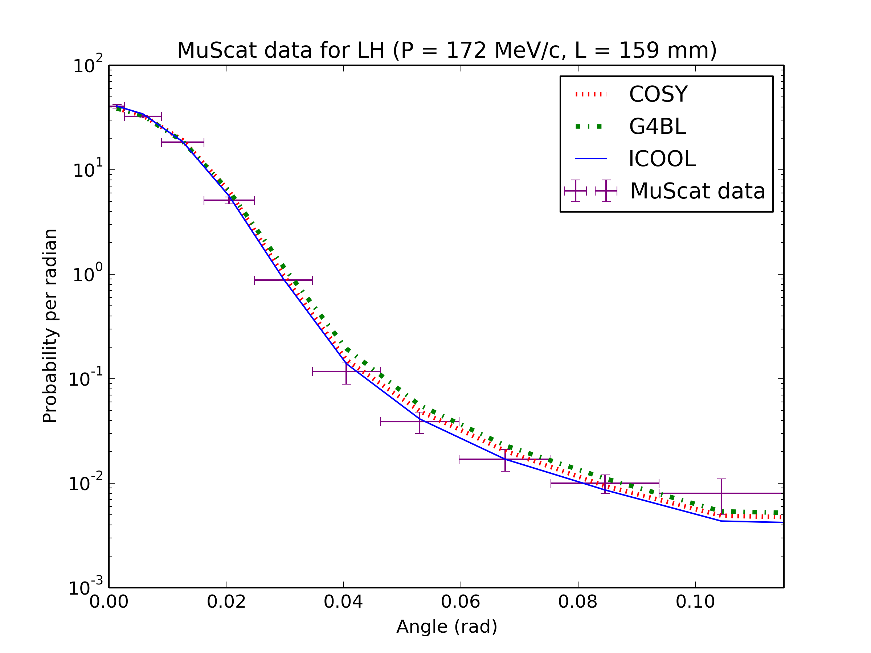
Results: Validation

Slide 36
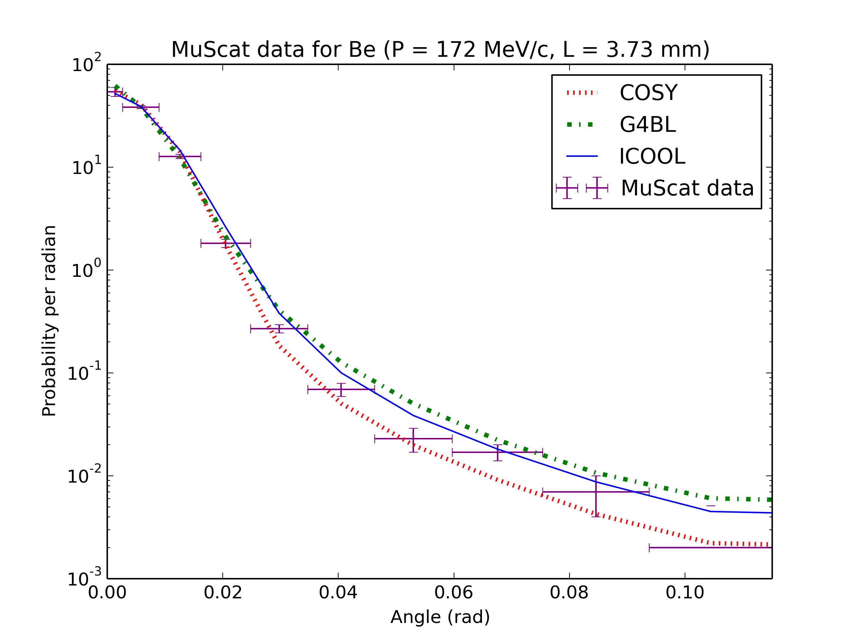
Results: Validation

Slide 37
Results: Benchmarking
Benchmarking: testing new software against known codes
Needed because little experimental data exists
All stochastic processes have been empirically altered to give reasonable agreement with two other codes, ICOOL and G4Beamline
36 benchmarking figures seen in thesis (12 figures with 3 sub-figures each)

Slide 38
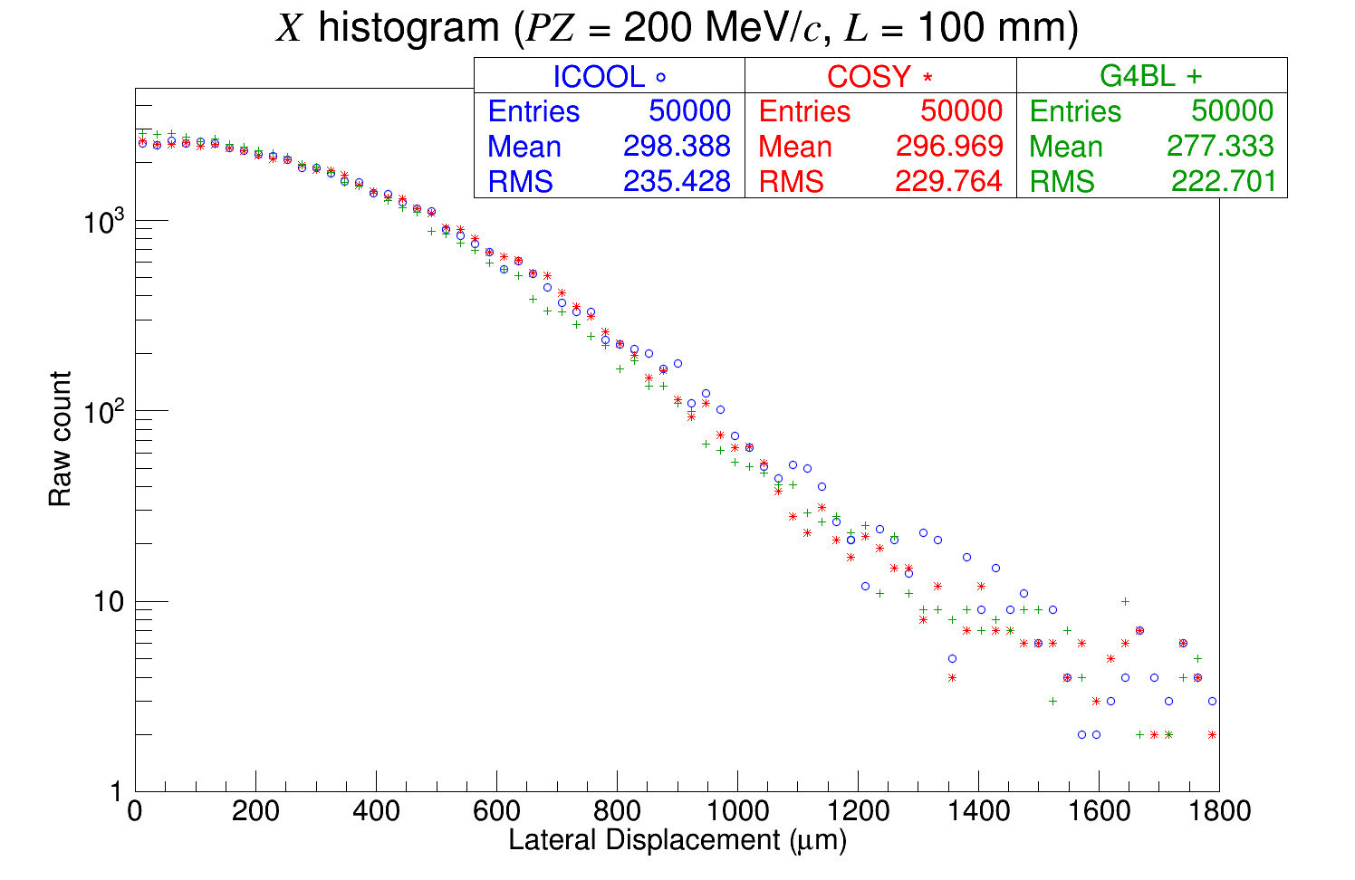
Pencil beam of 50k muons at 200 MeV/c through 100 mm of liquid hydrogen

Slide 39
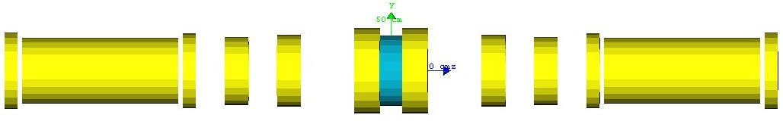
Results: MICE
The Muon Ionization Cooling Experiment (MICE) is an experiment being developed at Rutherford Appleton Laboratory in Oxfordshire, U.K.
Goal: a proof-of-principle demonstration of muon ionization cooling
MICE Step IV: 12 coils symmetric about an absorber

Slide 40
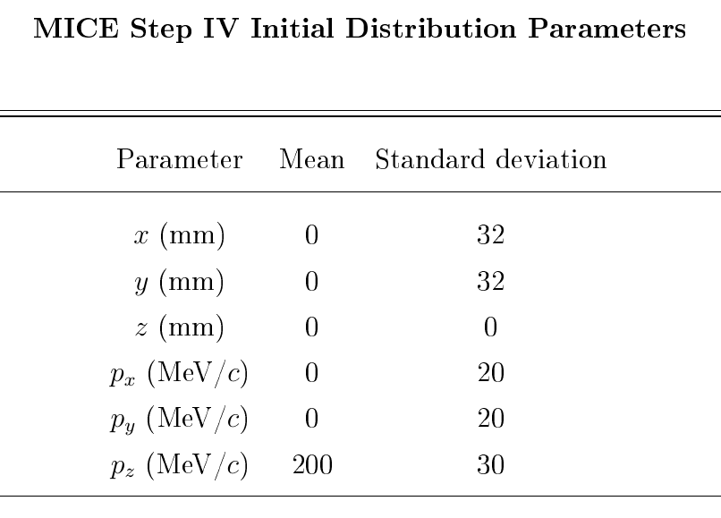
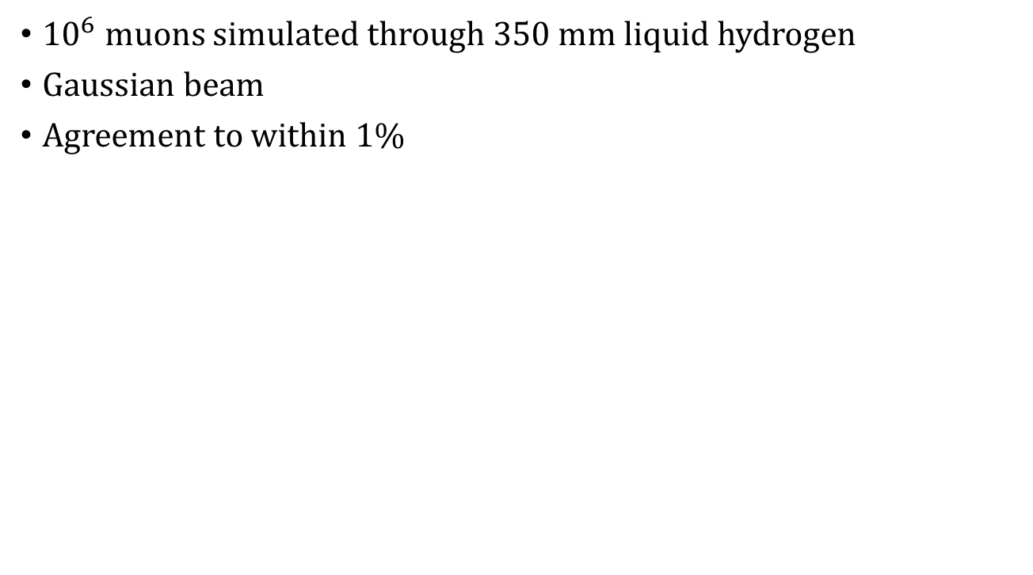
Results: MICE
${10}^{6}$ muons simulated through 350 mm liquid hydrogen
Gaussian beam
Agreement to within 1%

Slide 41
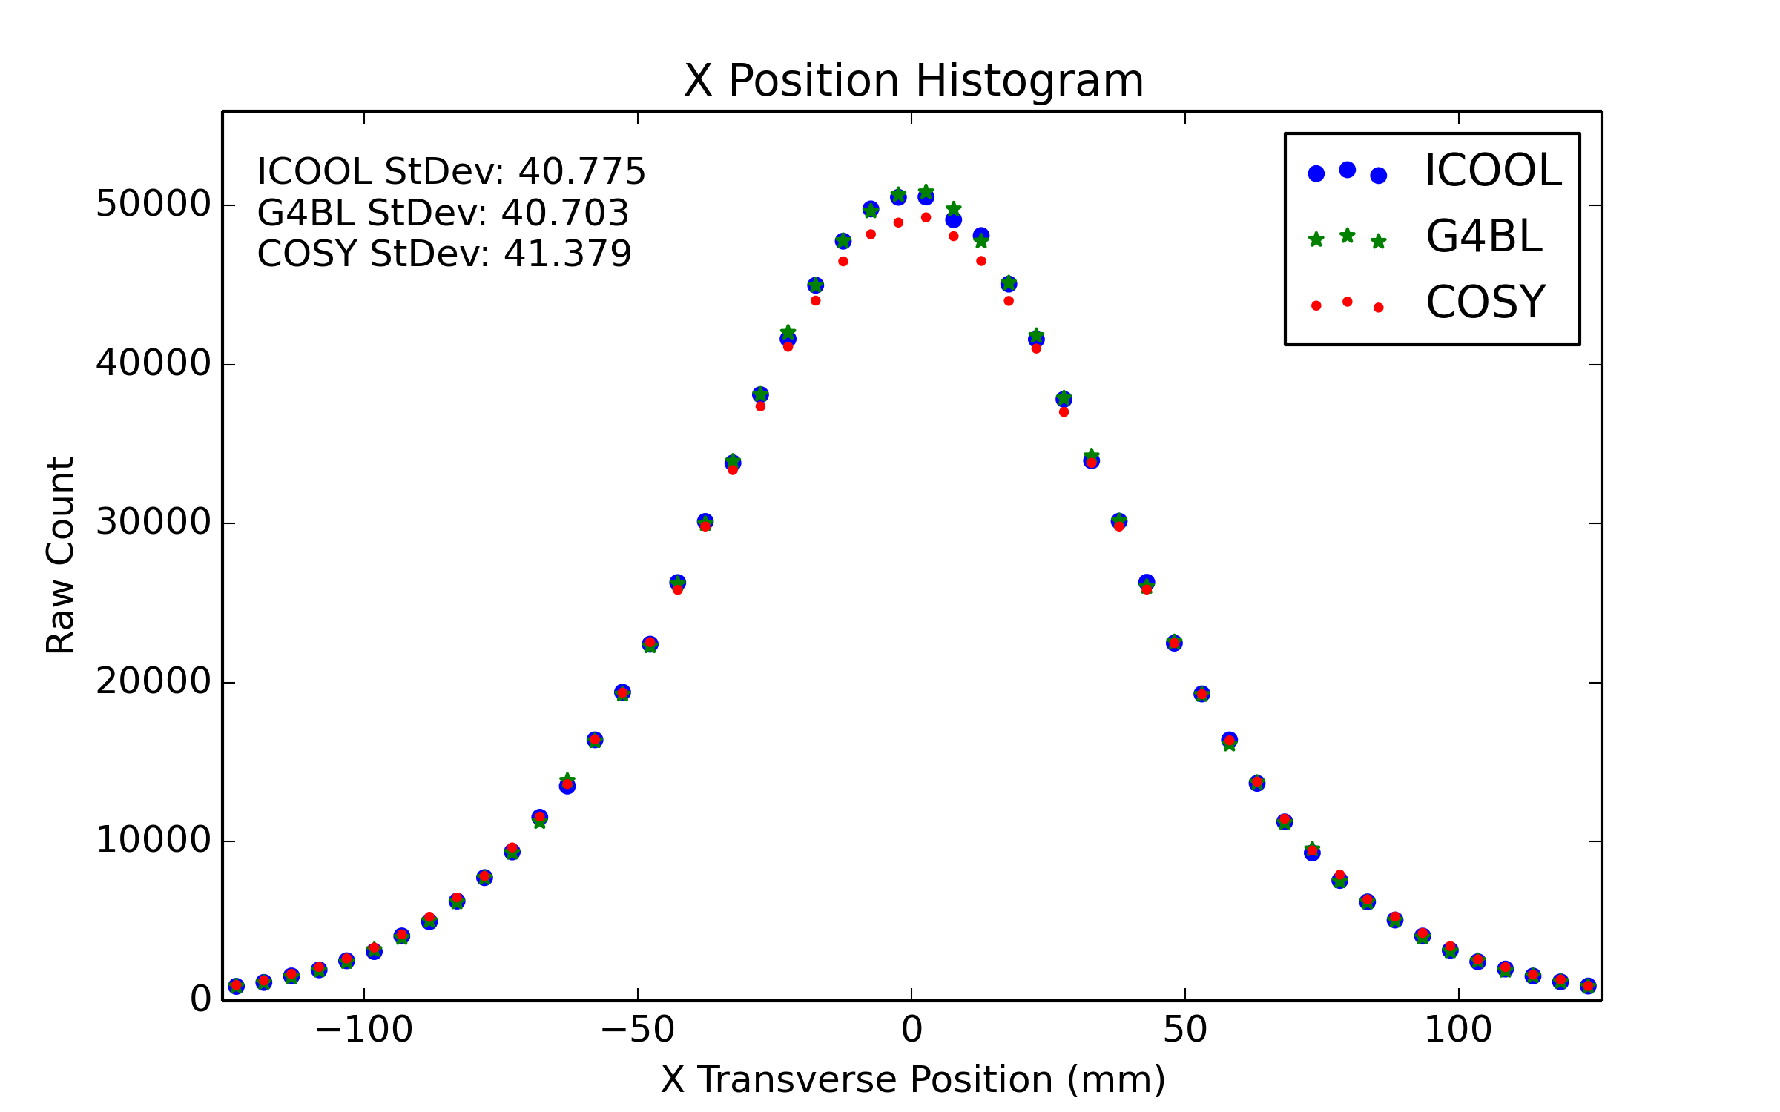
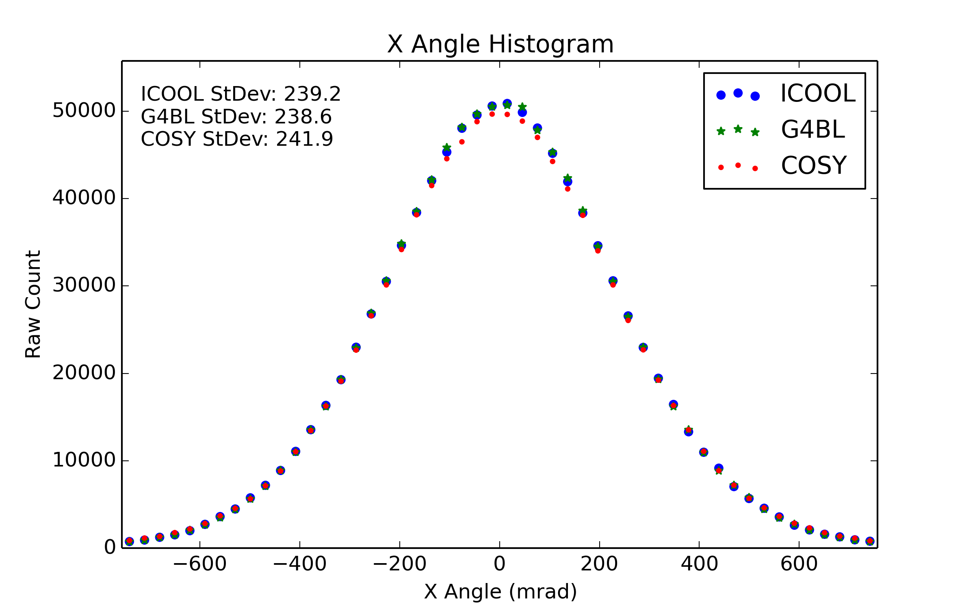
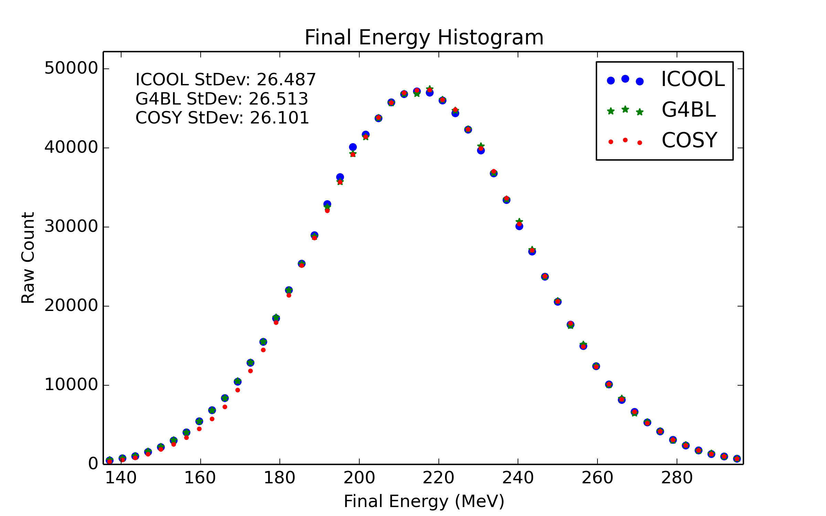

Slide 42
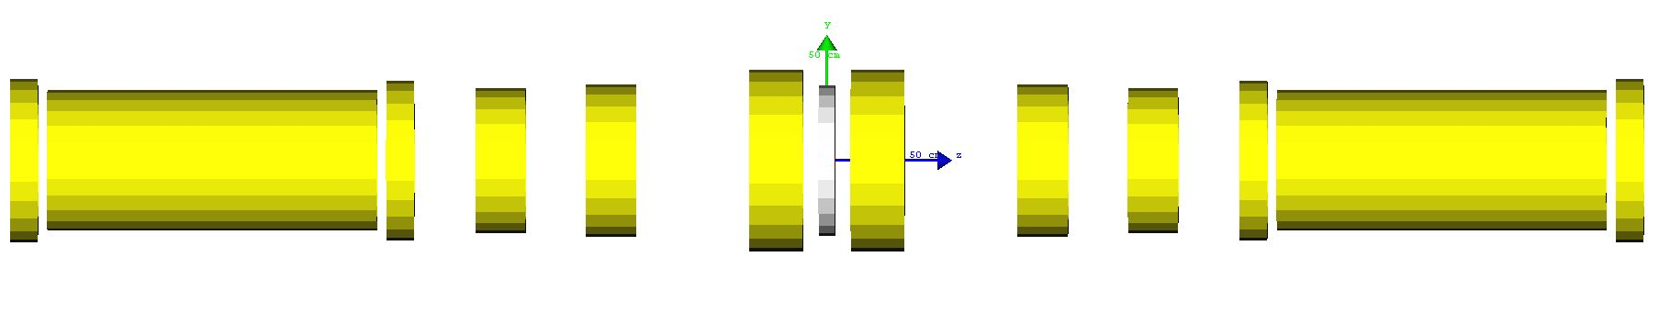
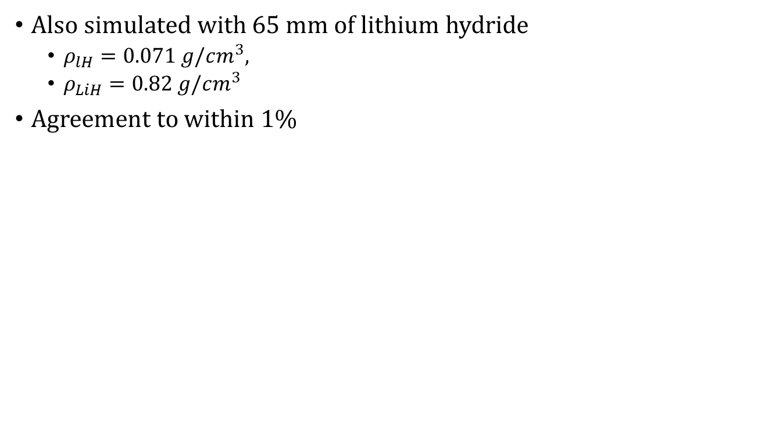
Results: MICE
Also simulated with 65 mm of lithium hydride
$ρ_{lH}=0.071 g/cm^{3},$
$ρ_{LiH}=0.82 g/cm^{3}$
Agreement to within 1%

Slide 43
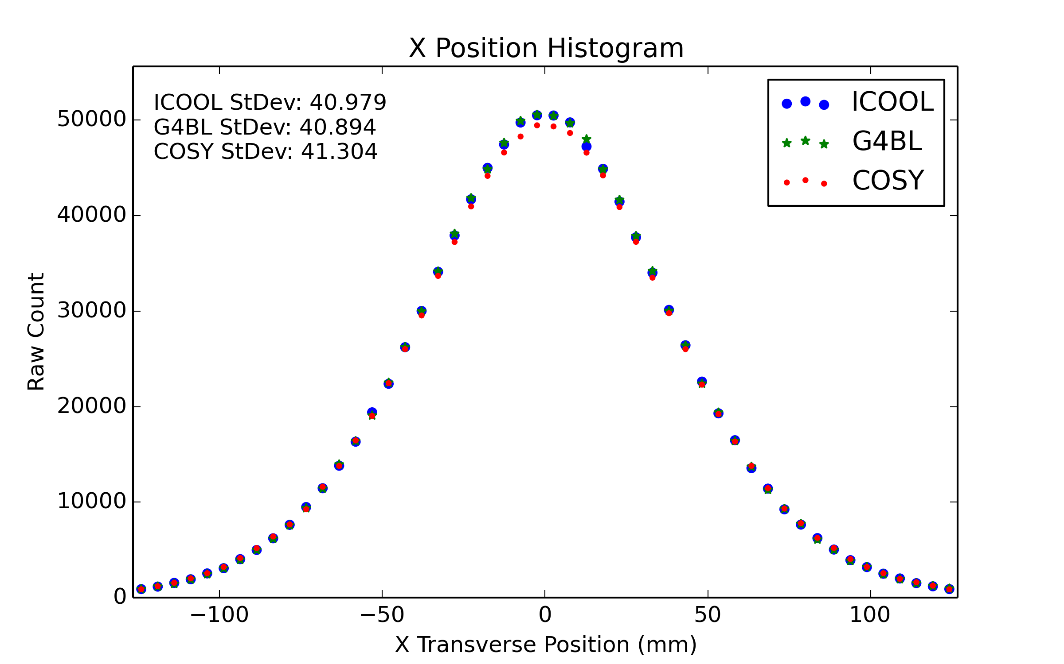
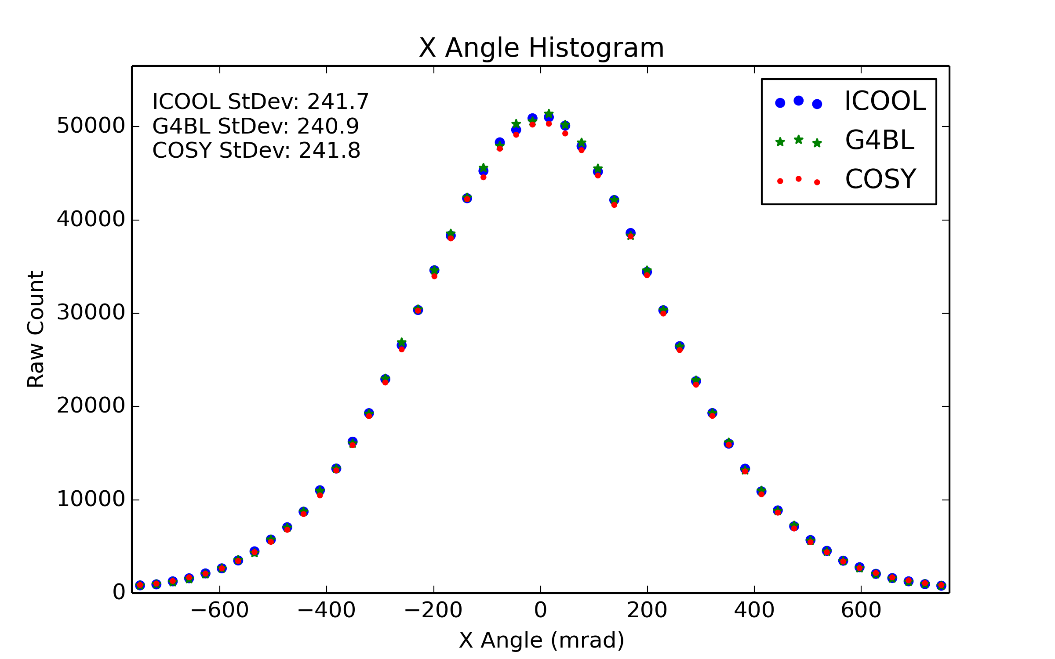
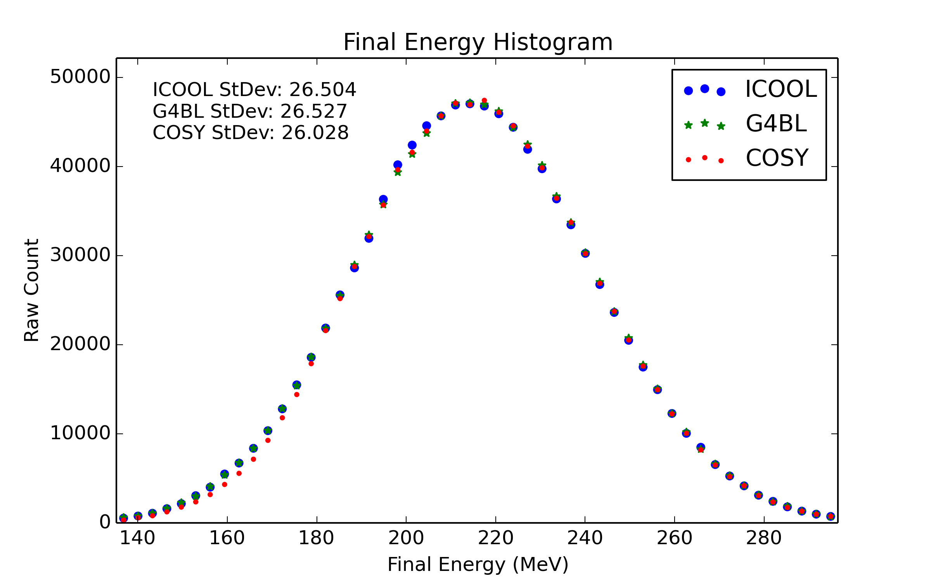

Slide 44

Results: MICE
Timed simulations for COSY, G4Beamline, and ICOOL
COSY roughly 50% the time of G4Beamline
COSY roughly 33% the time of ICOOL

Slide 45
Outline
Motivation
Fundamental particle physics
The Higgs Boson
Neutrinos
Muon facilities
Introduction to COSY Infinity
Transfer map methods
Transfer map example
Stochastic Processes
Ionization cooling
Why not use transfer maps?
Energy straggling
Multiple scattering
Results
Validation
Benchmarking
MICE
Summary

Slide 46
Summary
New stochastic processes implemented into COSY Infinity for particle-by-particle propagation
Uses hybrid transfer map–Monte Carlo method
First principle derivations to basic theory found in thesis
Corrections to basic theory novel in this work
Validation shows agreement with MuScat results
Benchmarking shows agreement with ICOOL, G4Beamline
Prediction of MICE Step IV results within 1% of other codes
Computation time for COSY twice as fast as other codes

Slide 47
Thank you!
(Questions?)

Slide 48
Backup Slides
Just in case!

Slide 49



Example: 2nd Order Map
$$−0.5x_{i}+3.1a_{i}$$
$$+5.2x_{i}^{2}+21.1x_{i}a_{i}+18.3a_{i}^{2} \\ −0.1y_{i}^{2}+0.32y_{i}b_{i}−2.13b_{i}^{2}$$
$$x_{f}=$$

Slide 50

Why low-Z Materials?
$$\frac{dε_{x}^{N}}{dz}=\frac{β_{⊥}}{2}\frac{E_{s}^{2}}{β^{3}Emc^{2}}\frac{1}{X_{0}}−\frac{1}{β}\left|\left\langle \frac{dE}{dz}\right\rangle \right|\frac{ε_{x}^{N}}{E}$$

Slide 51

Why low-Z Materials?
$$\frac{dε_{x}^{N}}{dz}=\frac{β_{⊥}}{2}\frac{E_{s}^{2}}{β^{3}Emc^{2}}\frac{1}{X_{0}}−\frac{1}{β}\left|\left\langle \frac{dE}{dz}\right\rangle \right|\frac{ε_{x}^{N}}{E}$$
heating term cooling term

Slide 52

Why low-Z Materials?
$$\frac{dε_{x}^{N}}{dz}=\frac{β_{⊥}}{2}\frac{E_{s}^{2}}{β^{3}Emc^{2}}\frac{1}{X_{0}}−\frac{1}{β}\left|\left\langle \frac{dE}{dz}\right\rangle \right|\frac{ε_{x}^{N}}{E}$$

Slide 53

Why low-Z Materials?
$$\frac{dε_{x}^{N}}{dz}=\frac{β_{⊥}}{2}\frac{E_{s}^{2}}{β^{3}Emc^{2}}\frac{1}{X_{0}}−\frac{1}{β}\left|\left\langle \frac{dE}{dz}\right\rangle \right|\frac{ε_{x}^{N}}{E}$$
$$X_{0}∝1/Z$$

Slide 54

Why low-Z Materials?
$$\frac{dε_{x}^{N}}{dz}=\frac{β_{⊥}}{2}\frac{E_{s}^{2}}{β^{3}Emc^{2}}\frac{1}{X_{0}}−\frac{1}{β}\left|\left\langle \frac{dE}{dz}\right\rangle \right|\frac{ε_{x}^{N}}{E}$$
$$X_{0}∝1/Z$$
$$heating term∝Z$$

Slide 55

Emittance Exchange

Slide 56

MICE Transverse Phase Space

Slide 57















Order 9
Steps:
30 through coils
5 through “absorber”
Transmission rates:
ICOOL: 99.0%
G4BL: 99.0%
COSY: 98.2%
Times:
ICOOL: 117 G4BL: 75 COSY: 166

Slide 58






Order 7
Steps:
2 upstream, 30 downstream
5 through “absorber”
Transmission rates:
ICOOL: 99.0%
G4BL: 99.0%
COSY: 98.0%
Times:
ICOOL: 117 G4BL: 75 COSY: 41

Slide 59
Publications
J. Kunz, P. Snopok, M. Berz, K. Makino. Hybrid methods for simulation of muon ionization cooling channels. Proc. of IPAC 16 (2016).
J. Kunz, P. Snopok, M. Berz, K. Makino. The advancement of cooling absrobers in COSY Infinity. Proc. of IPAC 15 (2015).
J. Kunz, P. Snopok, M. Berz, K. Makino. Matter-dominated muon accelerator lattice simulation tools for COSY Infinity. Microscopy and Microanalysis, in print (2015).
P. Snopok, J. Ellison, J. Kunz. Advanced simulation tools for muon-based accelerators. Cybernetics and Physics 3 (2014).
J. Kunz, P. Snopok, M. Berz, K. Makino. The development of stochastic processes in COSY Infinity. Proc. of IPAC 14 (2014).
P. Snopok, J. Kunz. Progress of the matter-dominated muon accelerator lattice simulation tools development for COSY Infinity. Proc. of NA-PAC 13 (2013).

